Slide 1


Manage MySQL
Users and Permissions
In Navicat
Navicat Certified Database Administrator - Associate

Slide 2

HKIIT - Navicat Certified Database Administrator - Associate
Lessons Intended Learning Outcome
On completion of this lesson(s), students are expected to be able to:
(#1) Manage MySQL users and their privileges in Navicat
(#2) Secure the MySQL root account using the Navicat User Management Tool
(#3) Assign Privileges with the Principle of Least Privilege (PoLP)

Slide 3
HKIIT - Navicat Certified Database Administrator - Associate
Learning Outline
User accounts and user roles in MySQL
User Privileges in MySQL
Access Control In MySQL
User management and Privilege assignment in Navicat.
Principle of Least Privilege (PoLP)

Slide 4

HKIIT - Navicat Certified Database Administrator - Associate
RESPONSIBILITY
Managing the users of a database
Coordinating how users in your organization access your database typically entails many separate tasks, from adding new users, blocking access to users who have left the organization, and helping users who cannot log in.

Slide 5
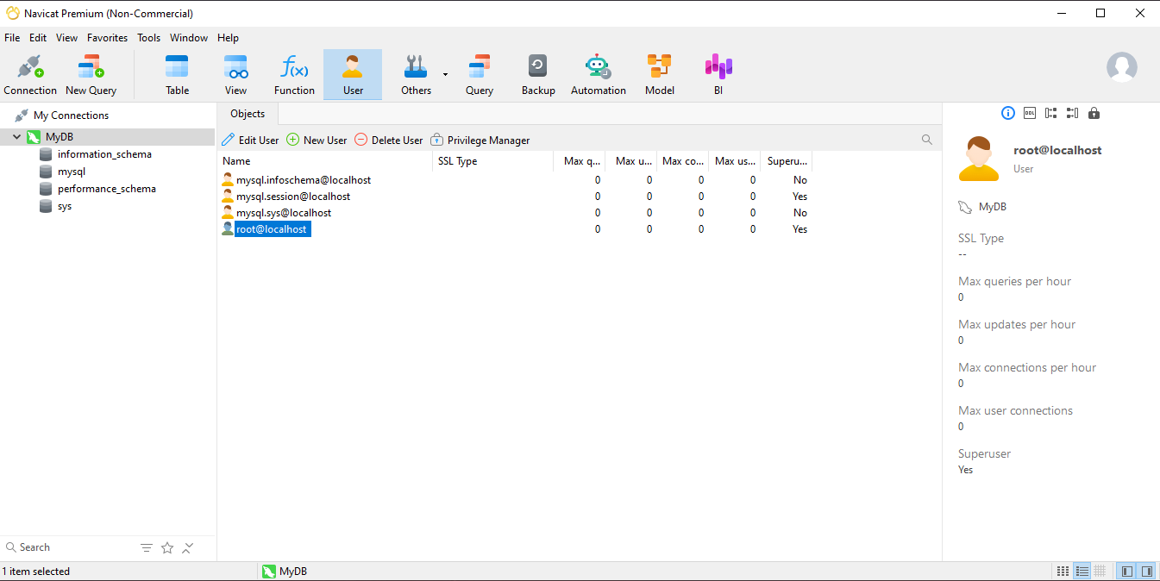
USER MANAGEMENT
HKIIT.
Managing MySQL users
in Navicat Premium

Slide 6

HKIIT - Navicat Certified Database Administrator - Associate
USER MANAGEMENT
Default User Accounts
MySQL creates three default user accounts during installation:
‘root’@‘localhost’:
The super user with all privileges.
‘mysql.sys’@‘localhost’:
Used as the DEFINER for sys schema objects.
‘mysql.session’@‘localhost’:
Used internally by plugins to access the server.
'mysql.infoschema'@'localhost’:
Used as the DEFINER for INFORMATION_SCHEMA views.
Account are locked and cannot be used for client connections.
Notes:
-access to database metadata, information about the MySQL server such as the name of a database or table, the data type of a column, or access privileges.

Slide 7
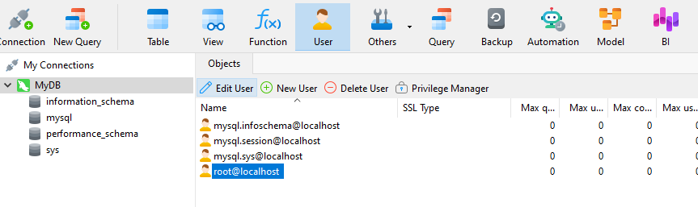
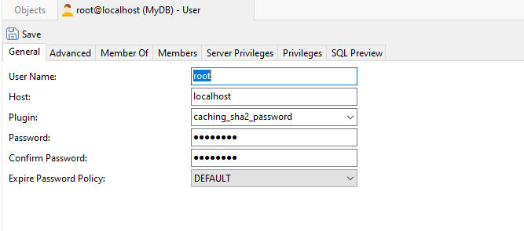
HKIIT - Navicat Certified Database Administrator - Associate
7
Editing User Details
1. Click the Edit User button
on the Objects toolbar
2. That opens an Editor tab for that user.

Slide 8
HKIIT - Navicat Certified Database Administrator - Associate
8
Editing User Details
Basic user properties like the User Name, Host, and Password under the General tab.

Slide 9
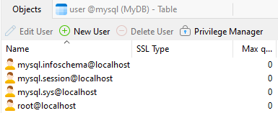
HKIIT - Navicat Certified Database Administrator - Associate
9
Local vs. Remote Access
Users can be specified as localhost or remote accounts
Localhost accounts can only connect if on same machine as MySQL Server
Remote accounts can connect from other machines on the network
A user with only local access
username@localhost
username@127.0.0.1
A user that can connect from any computer
Username@%
A user than can only connect from a particular domain
username@'%.domainname.com'

Slide 10
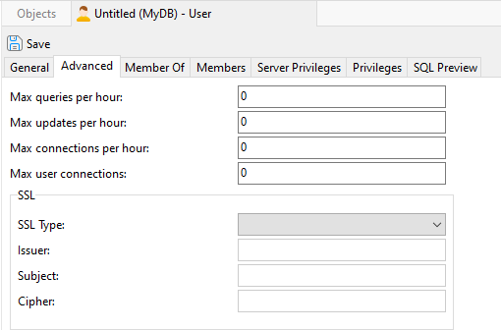
HKIIT - Navicat Certified Database Administrator - Associate
Advanced Setting
10
Account Limits
To limit for individual accounts on use of various server resources.
The number of queries an account can issue per hour.
The number of updates an account can issue per hour.
The number of times an account can connect to the server per hour.
The total number of database connections an account can make.
MySQL :: MySQL 8.0 Reference Manual :: 15.7.1.1 ALTER USER Statement

Slide 11
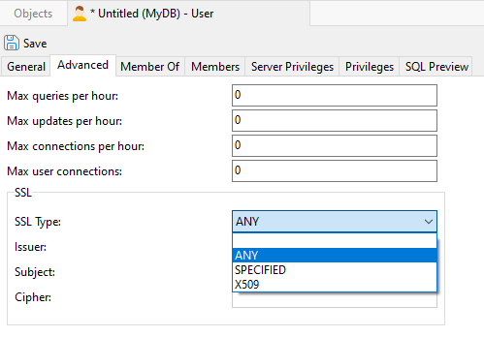
HKIIT - Navicat Certified Database Administrator - Associate
Advanced Setting
11
Setting SSL Encryption
To limit for individual accounts on use of various server resources.
ANY:
Tells the server to permit only encrypted connections for this account.
X509:
Requires that clients present a valid certificate, but the exact certificate, issuer, and subject do not matter
MySQL :: MySQL 8.0 Reference Manual :: 15.7.1.1 ALTER USER Statement

Slide 12
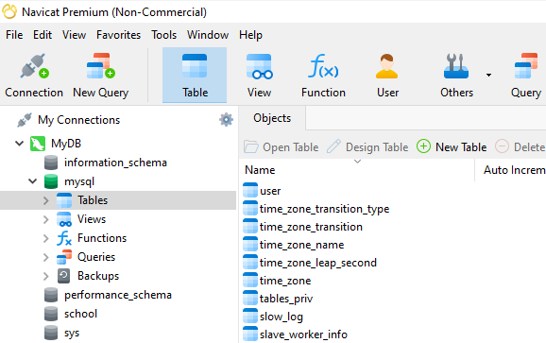
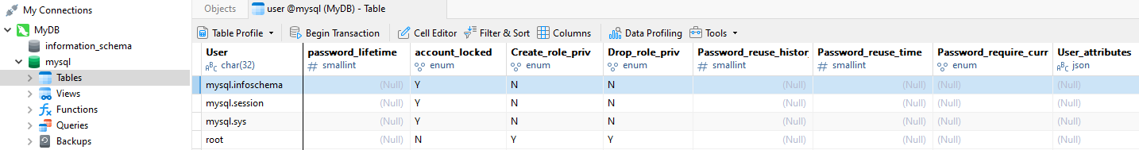
HKIIT - Navicat Certified Database Administrator - Associate
USER MANAGEMENT
12
Account Locking
MySQL stores user account information in the `mysql.user` table.
To check if a user is locked:
The `account_locked` column indicates whether the account is locked (`Y` or `N`).
Accounts are locked and cannot be used for client connections.
MySQL :: Security in MySQL :: 4.20 Account Locking
Notes:
-access to database metadata, information about the MySQL server such as the name of a database or table, the data type of a column, or access privileges.

Slide 13

HKIIT - Navicat Certified Database Administrator - Associate
13
Navicat
03. Securing the Root Account
The root user credential is the most privileged account in an AWS account, with full access to all resources, services, and permissions.
This makes it a prime target for cybercriminals seeking to exploit it for malicious purposes. Losing your root user credentials can result in unauthorized access, data breaches, and financial losses.

Slide 14
HKIIT - Navicat Certified Database Administrator - Associate
USER MANAGEMENT
14
HKIIT.
Securing the Root Account
1. To obscure the identity of the super user account.
The default root account is widely known and often targeted by attackers.
Rename it to something less intuitive
(e.g.secure_admin_99)
Make it harder for unauthorized users to guess the username

Slide 15
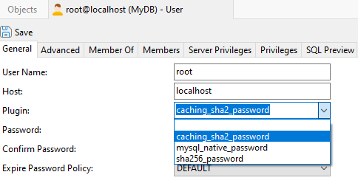
HKIIT - Navicat Certified Database Administrator - Associate
USER MANAGEMENT
15
HKIIT.
Securing the Root Account
2. Change authentication plugin
‘mysql_native_password’ was the default authentication plugin in older versions (< 8.0)
Choose the caching_sha2_password Plugin
Stronger Hashing Algorithms
SHA-256 vs SHA1
Improved Performance
Caching Mechanism
Notes:
MySQL client programs in MySQL 8.4 (and later) use caching_sha2_password for authentication by default.
caching_sha2_password: Implements SHA-256 authentication (like sha256_password), but uses caching on the server side for better performance and has additional features for wider applicability.
sha256_password (deprecated): Implements basic SHA-256 authentication. This is deprecated and subject to removal, do not use this authentication plugin.

Slide 16

HKIIT - Navicat Certified Database Administrator - Associate
USER MANAGEMENT
16
HKIIT.
Securing the Root Account
3. Provide a strong password
Strong passwords should be difficult to guess or crack.
A good password:
Is at least eight characters long.
Doesn't contain your user name, real name, or company name.
Doesn't contain a complete word.
Is significantly different from previous passwords.
Contains uppercase letters, lowercase letters, numbers, and symbols.

Slide 17
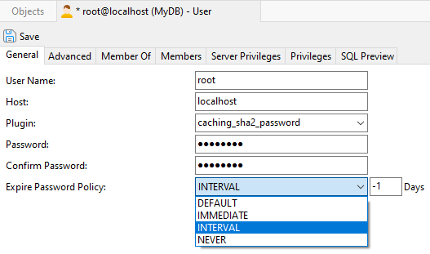
HKIIT - Navicat Certified Database Administrator - Associate
USER MANAGEMENT
17
HKIIT.
Securing the Root Account
4. Setting an Expire Password Policy
To ensure passwords are regularly updated, reducing the risk of long-term exposure.
Force users to change their passwords periodically
(e.g., 90 days)
Notes:
DEFAULT: Sets the password expiration length to the database default. Prior to version 5.7.11, the Default Value was 360 days. Since version 5.7.11 onwards, the Default Value is 0 days, which effectively disables automatic password expiration.
IMMEDIATE: Expires an account password, thus forcing the user to update it.
INTERVAL: Specifies the number of days in which the current password expires.
NEVER: Allows the current password to remain active indefinitely. Useful for scripts and other automated processes.

Slide 18




04. MySQL User Permissions
Gives
To
MySQL
User Account
Permission
Server Action
Navicat
Configuring User Privileges
The MySQL user account is assigned user permissions, which determine the actions that the user is allowed to perform on the server.
HKIIT - Navicat Certified Database Administrator - Associate

Slide 19
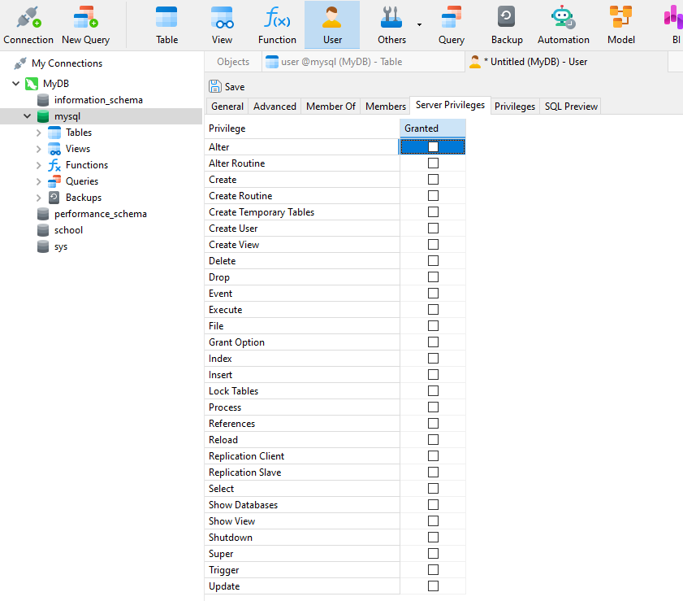
User Permissions
Server Privileges
A list of privileges that apply to the server connection as a whole.
Privilege Levels: Global
All databases and tables
To assign a privilege, simply check the option against the server privilege listed.
HKIIT - Navicat Certified Database Administrator - Associate

Slide 20
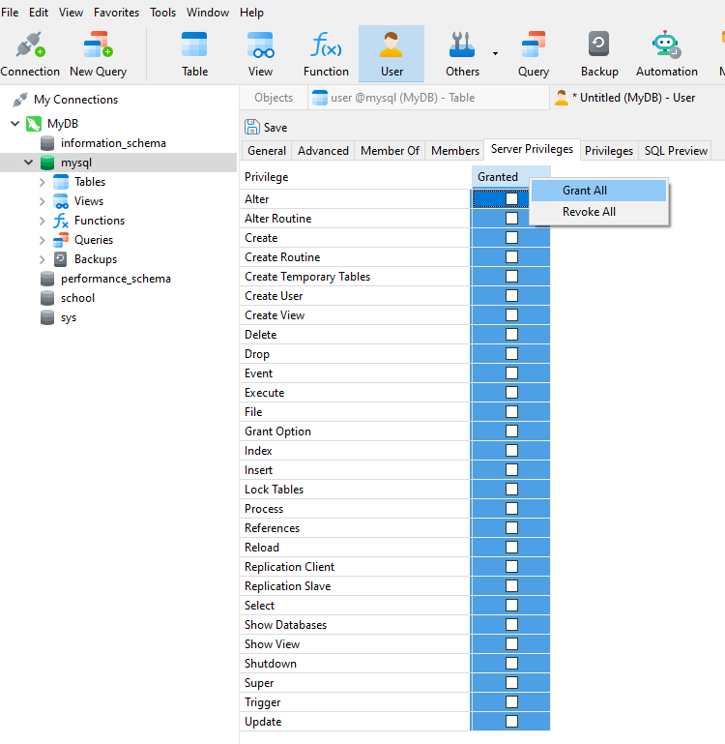
User Permissions
Server Privileges
Grant or Revoke all privileges at once
Right-clicking on the server privileges tab
Choosing the appropriate option from the context menu.
HKIIT - Navicat Certified Database Administrator - Associate

Slide 21
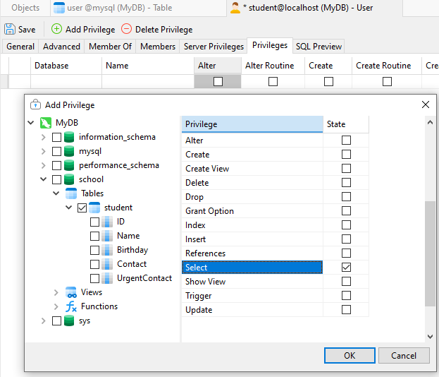
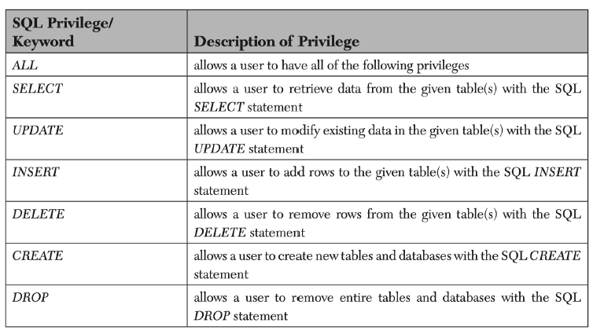
User Permissions
Privileges
MySQL :: MySQL 8.4 Reference Manual :: 8.2.2 Privileges Provided by MySQL
HKIIT - Navicat Certified Database Administrator - Associate

Slide 22
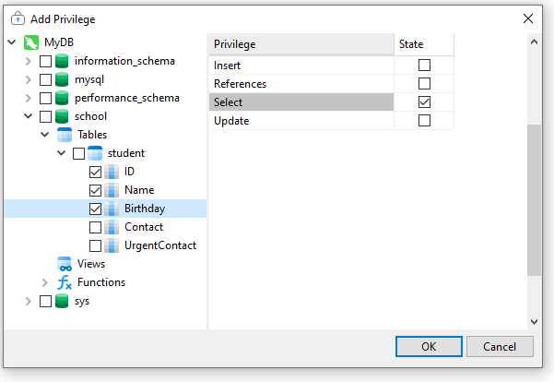
User Permissions
Privileges
Database-level
Access all of the data within the database
Table-level
Access given tables of a database
Column-level
Access specific columns
Row-level
Access specific rows
HKIIT - Navicat Certified Database Administrator - Associate

Slide 23
User Permissions
Principle of Least Privilege
Grant specific object privileges to users (e.g., based on their current job duties)
Rather than broad system privileges that allow access to all objects in the database
Revoke the privilege when job duties change/users leave the company
HKIIT - Navicat Certified Database Administrator - Associate

Slide 24
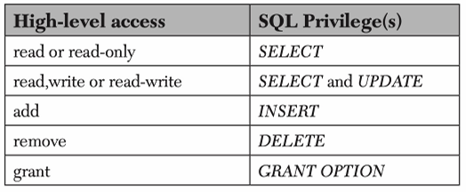
User Permissions
High-Level Access to SQL Table Privilege
HKIIT - Navicat Certified Database Administrator - Associate

Slide 25
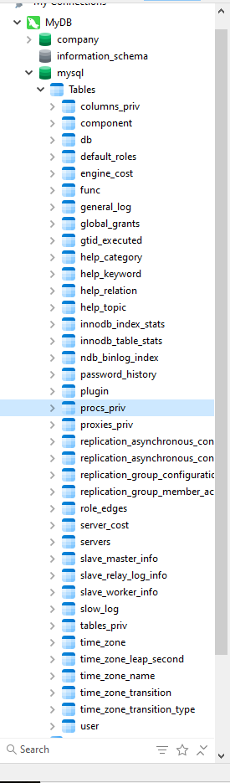
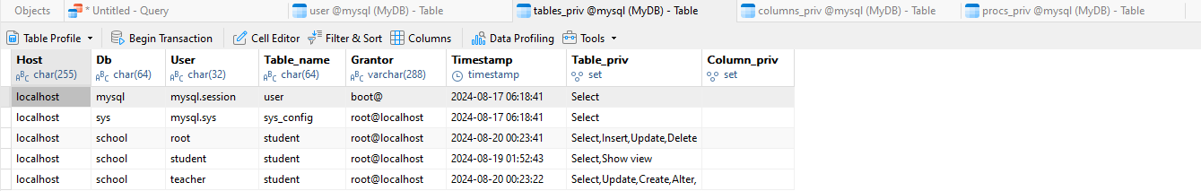
User Permissions
Access Control In MySQL
Information about user privileges is stored in the user, db, host, tables_priv, columns_priv, and procs_priv tables in the database named mysql.
The MySQL server reads the contents of these tables when it starts.
HKIIT - Navicat Certified Database Administrator - Associate

Slide 26
User Permissions
Access Control In MySQL
MySQL access control involves two stages when you run a client program that connects to the server, in this case Navicat:
Stage 1:
The server checks whether it should allow you to connect.
Stage 2:
Assuming that you can connect, the server checks each statement you issue to determine whether you have sufficient privileges to perform it.
For example, the Create table privilege, the Drop table privilege, or the Alter table privilege.
The server uses the user, db, and host tables in the mysql database at both stages of access control.
HKIIT - Navicat Certified Database Administrator - Associate

Slide 27
HKIIT - Navicat Certified Database Administrator - Associate
USER MANAGEMENT
27
HKIIT.
Managing user privileges
in Navicat Premium
Privilege Manager Button
gives an under-the-hood view of all the connections to the defined servers, all the databases that they have, and all kinds of privileges that are defined and set for all of the users that exist in them.

Slide 28
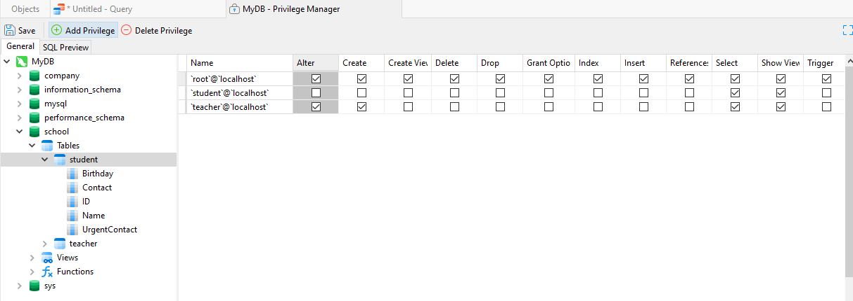
HKIIT - Navicat Certified Database Administrator - Associate
USER MANAGEMENT
28
HKIIT.
Managing user privileges
in Navicat Premium
Manage all users for all schemas, and a matrix of all privileges for an entire server, or for specific catalogs (databases) from within a single window.

Slide 29

Navicat
Managing Users and Permissions
We have explored various aspects of MySQL user management using Navicat, focusing on how to create, modify, and delete user accounts through its visual tools. We now know how to secure the MySQL root account, assign privileges following the principle of least privilege (PoLP), and manage user permissions to ensure a secure database environment.
HKIIT - Navicat Certified Database Administrator - Associate

